Slide 1

Process Maps As Code
With mermaid
Richard Jackson | @jacksorjacksor
Umbraco Kent Meetup | 14th November 2024

Slide 2
CONTENTS
Introduction (“The meme that haunts”)
Code to visuals (“Graphic design for developers”)
Mermaid JS
Reflections (“Why bother?”)

Slide 3
ABOUT ME

Slide 4
1. The Meme that haunts

Slide 5







Slide 6
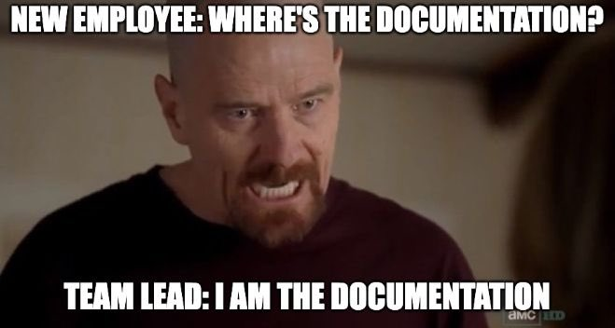

Slide 7
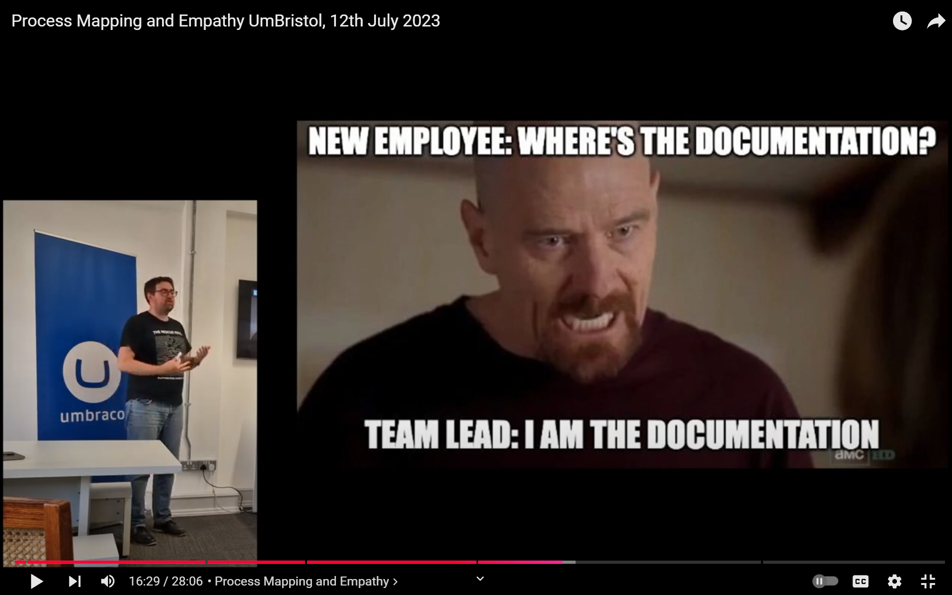

Slide 8
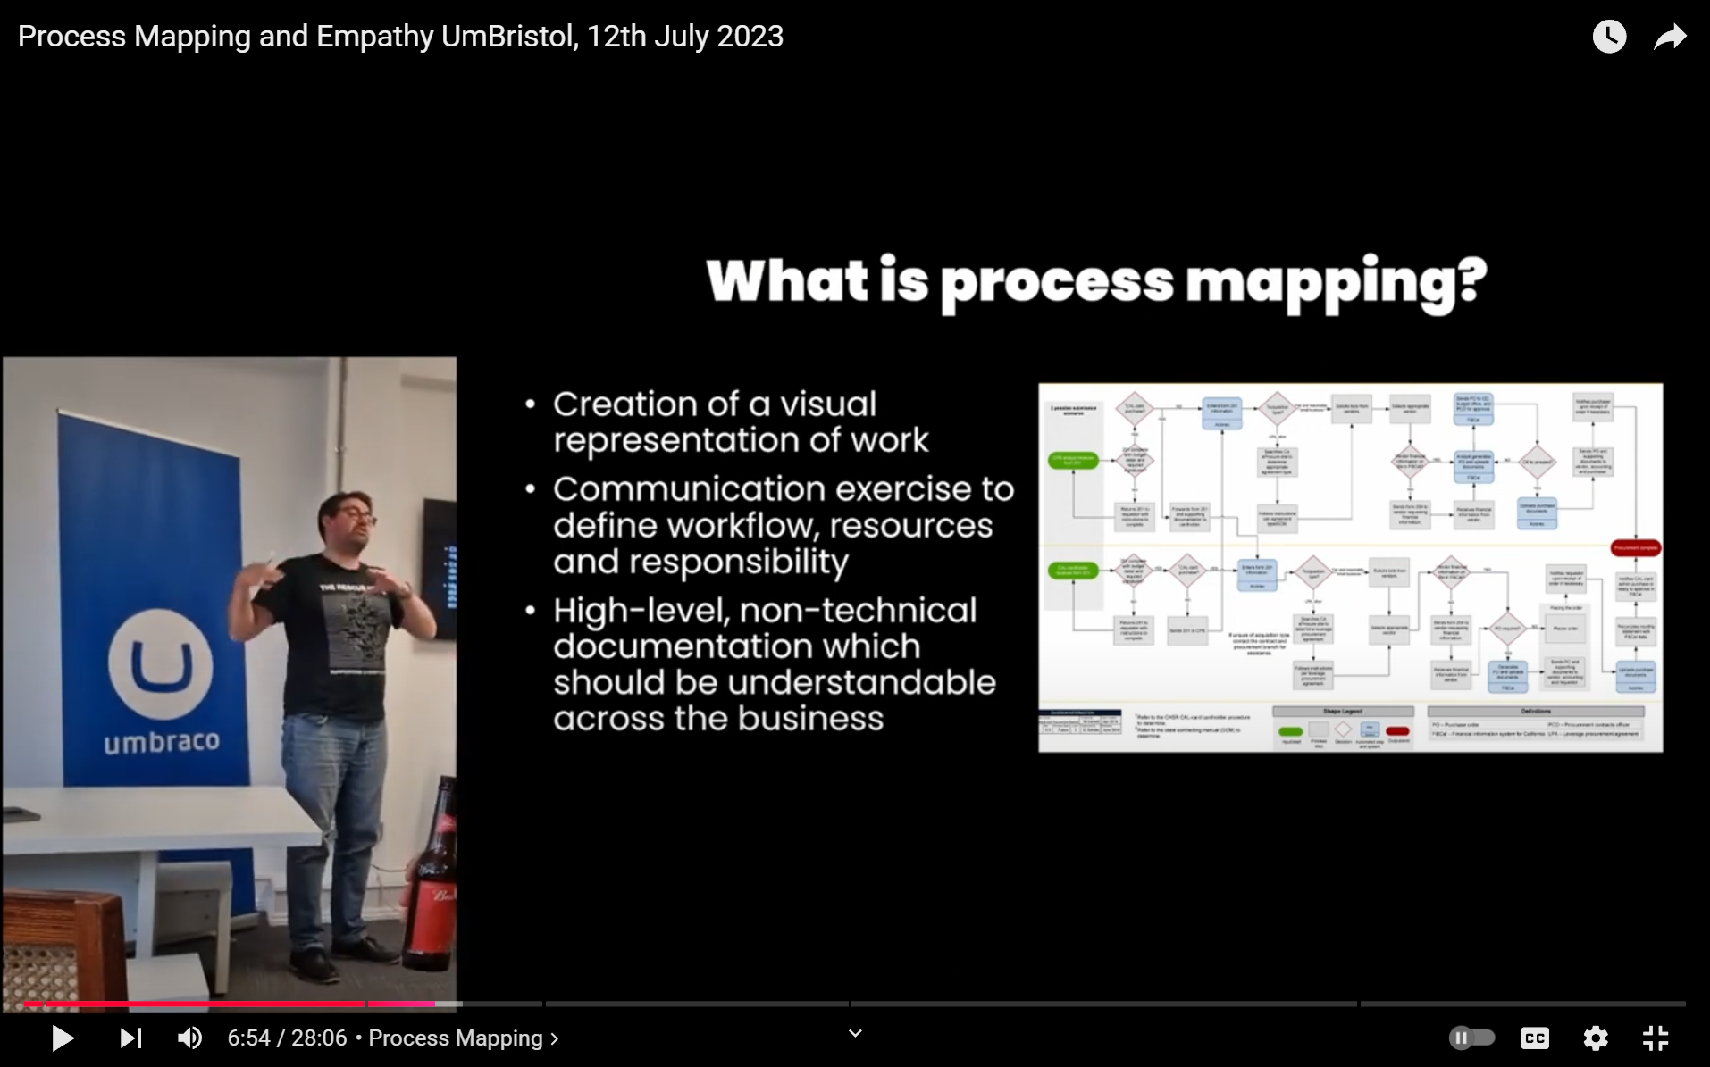

Slide 9
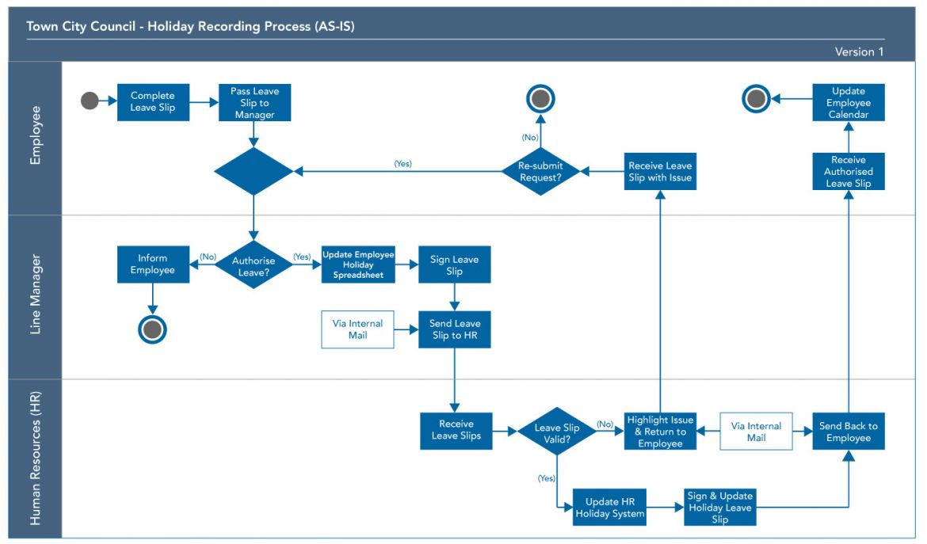
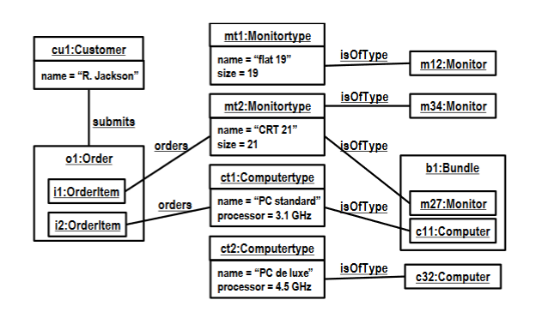
Different levels of process visualisation
Process Mapping
Process MODELLING
High-level
Subjective
Low-level
Objective

Slide 10

Benefits of process mapping
Provides single source of truth for discussion, iteration and improvement
Challenges assumptions
Reduces tacit knowledge
Improve onboarding of new staff
Creates empathy between departments

Slide 11
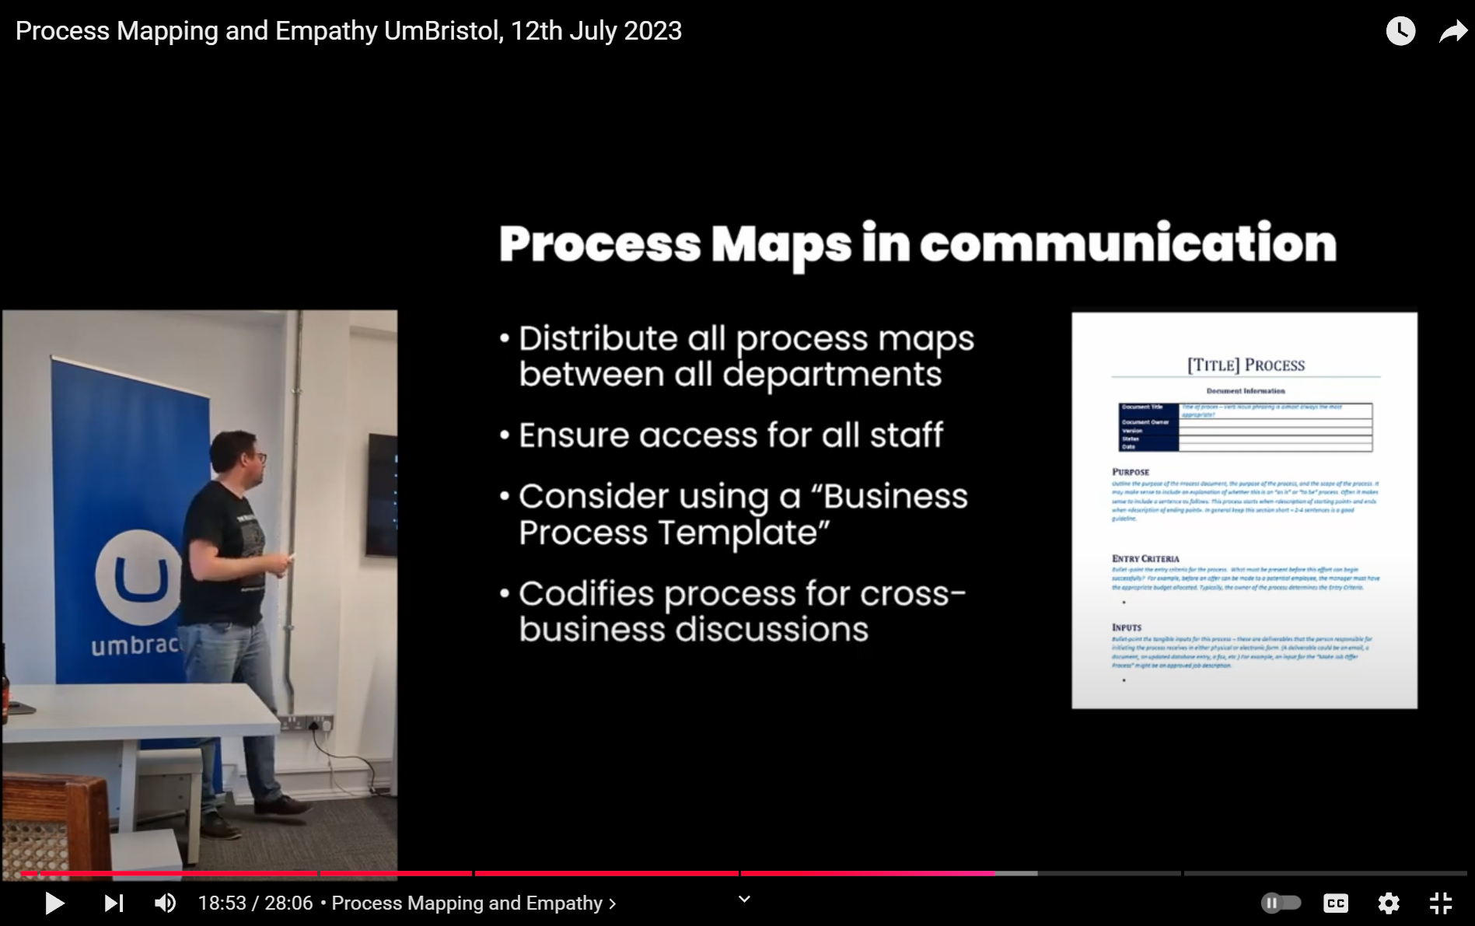

Slide 12



Graphics Packages for Process Mapping
Diagrams.net
(formally Draw.io)
Lucidchart
Microsoft Visio

Slide 13
Key problems
Separate file to the work
Requires upskilling on graphics package
Developers not necessarily comfortable with aesthetic design
Maps can become unwieldy as scope increases
Proprietary file formats

Slide 14
2. Process Maps As Code (hey it’s the name of the talk)

Slide 15
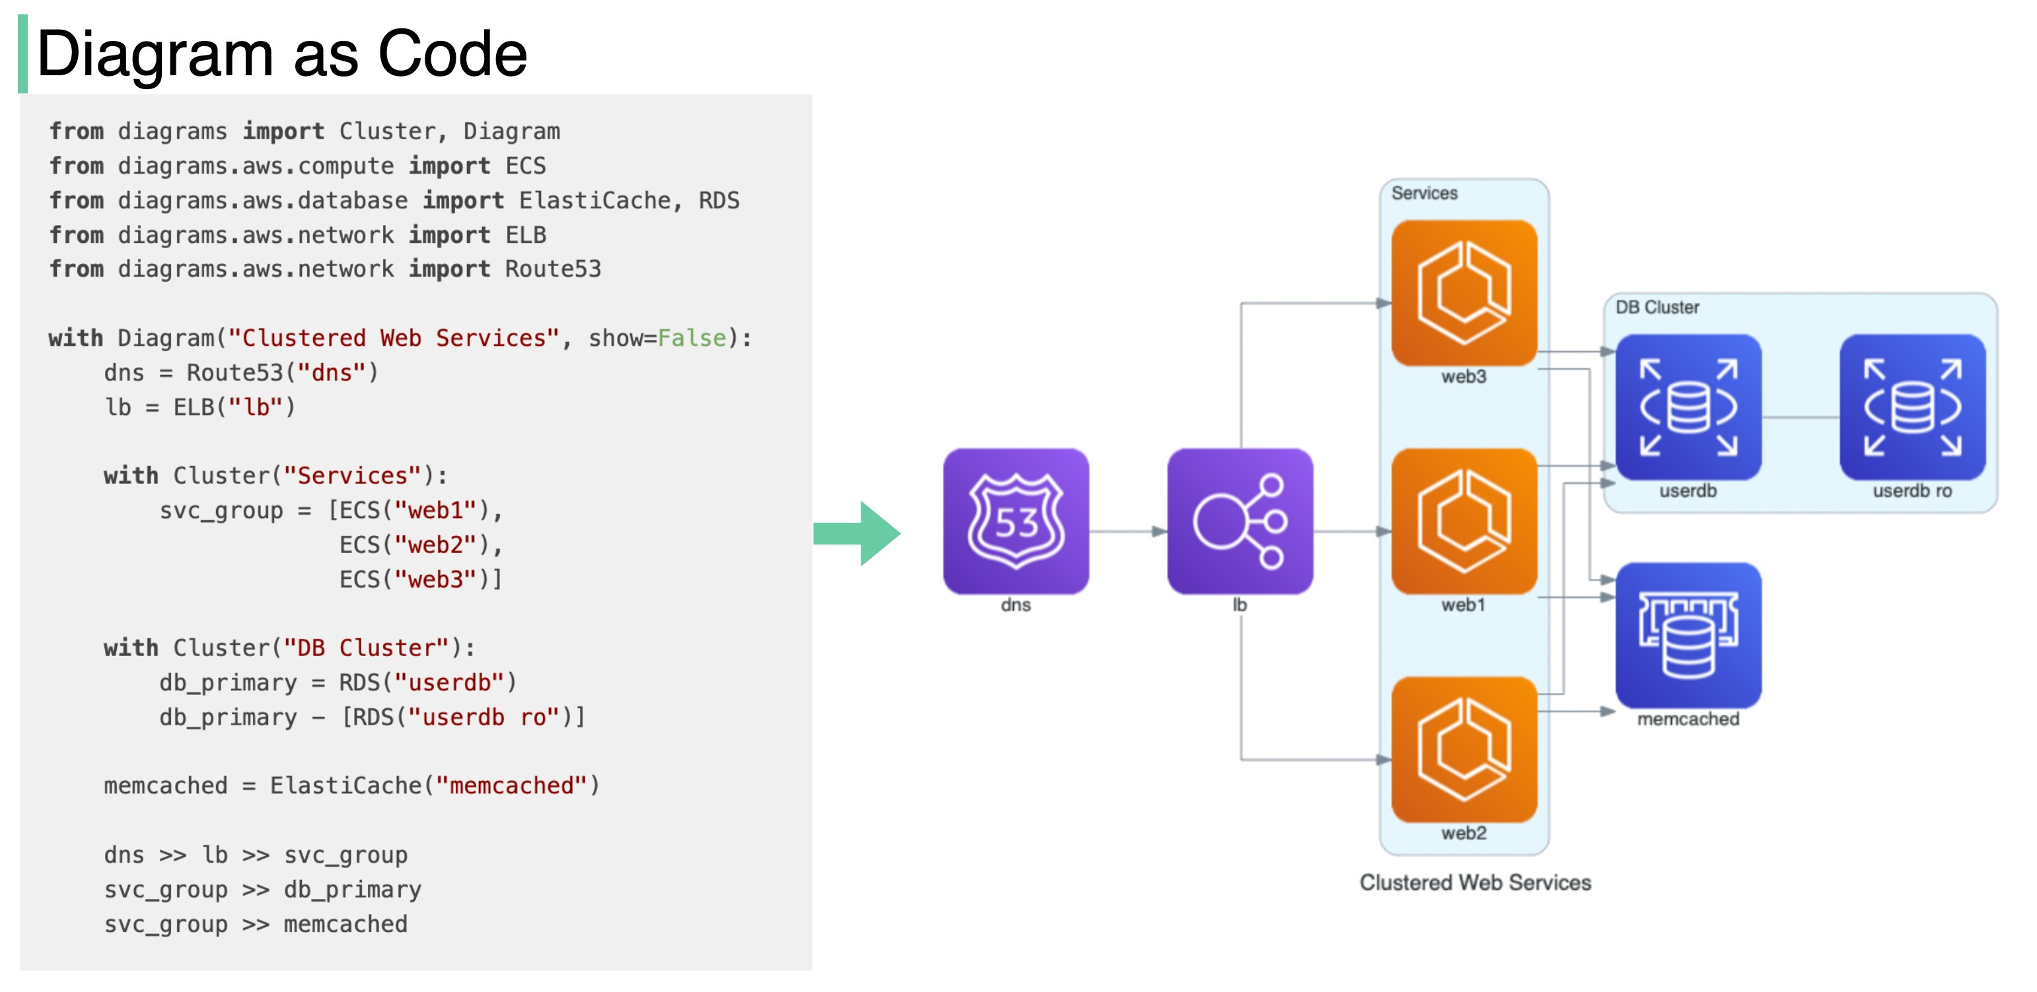
PROCESS MAPs AS CODE
Source: Diagram as Code - by Alex Xu - ByteByteGo Newsletter

Slide 16

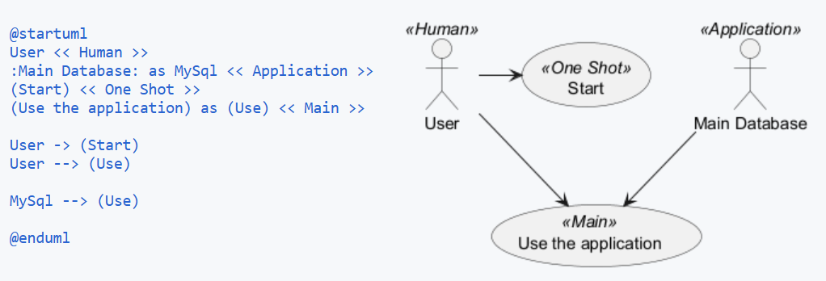
PlantUML

Slide 17

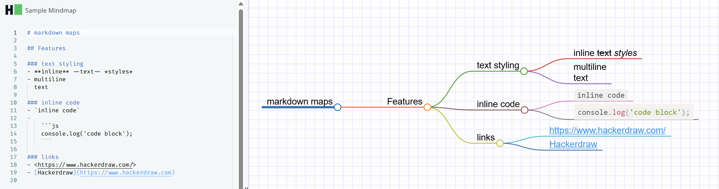
HackerDraw

Slide 18
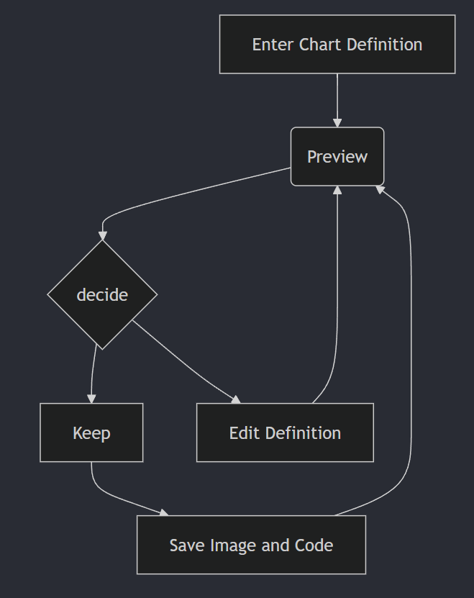
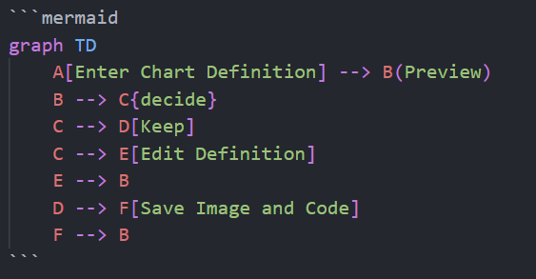
Mermaid

Slide 19
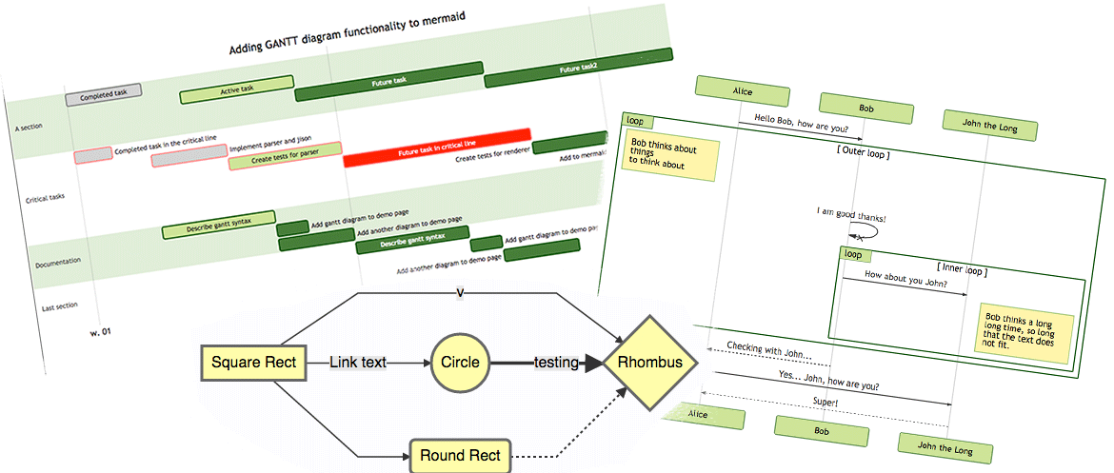
About Mermaid
JavaScript-based diagramming and charting tool
Won the JS Open Source Awards (2019) category "The most exciting use of technology"!!!
Goal: “help documentation catch up with development”

Slide 20
3. Integration

Slide 21

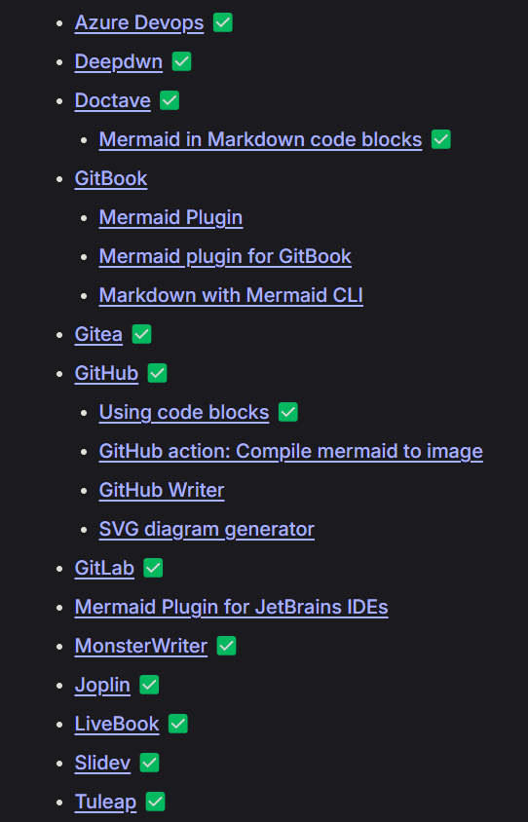
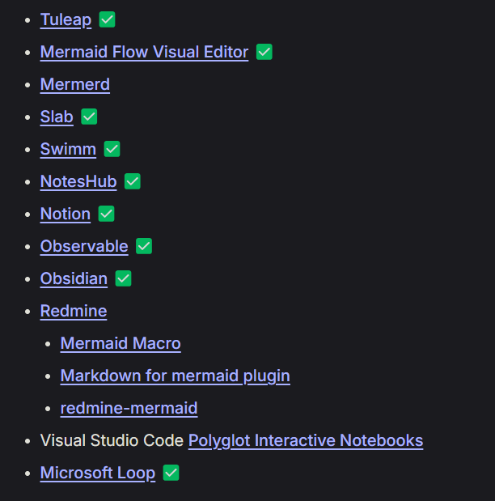
Mermaid JS Integrations
Native support for Mermaid
Notes:
Source control platforms
Notetaking / information management tools

Slide 22

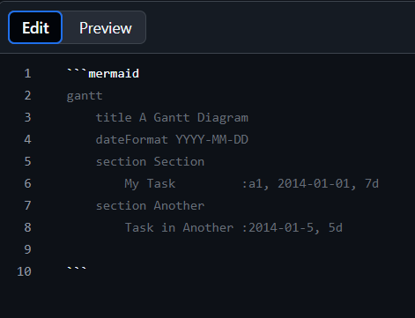
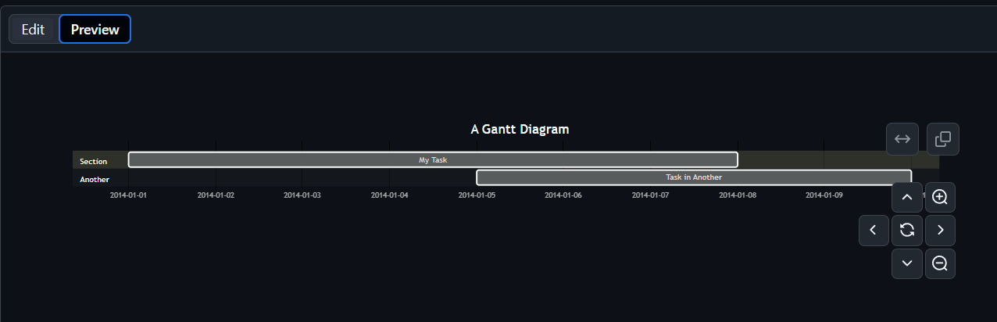
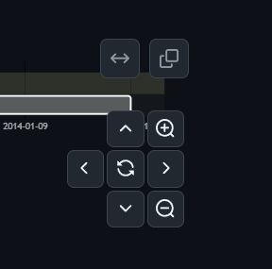
GitHub
Any Markdown file
Available since Feb 2022:
Include diagrams in your Markdown files with Mermaid - The GitHub Blog

Slide 23
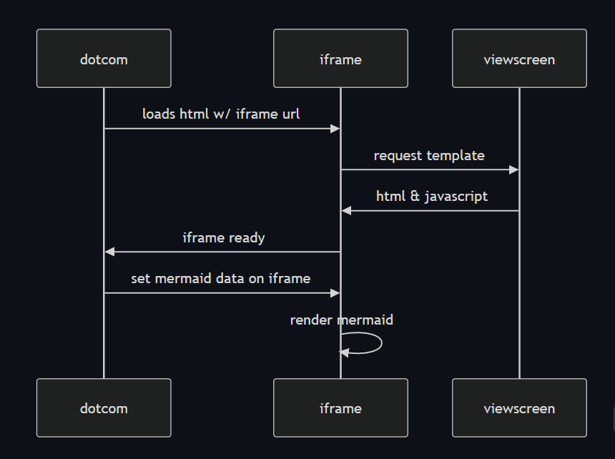
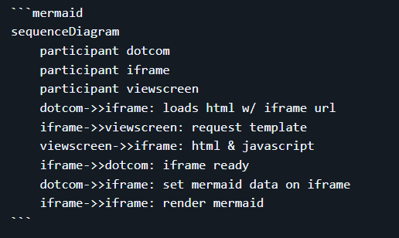
GitHub Mermaid rendering Process
Source: GitHub HTML Rendering Pipeline

Slide 24

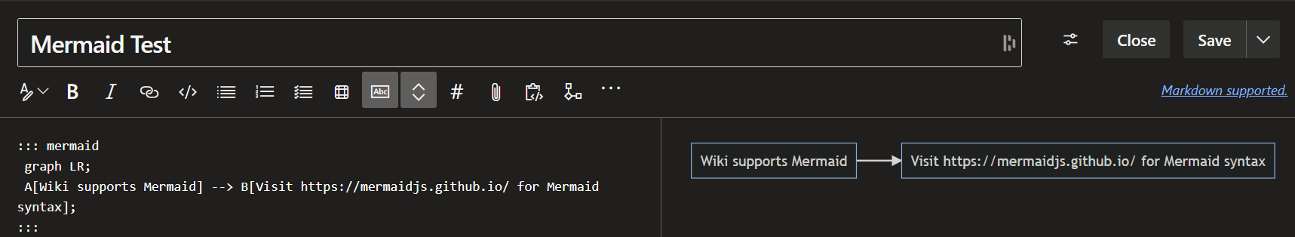
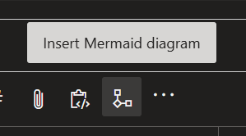
Azure DevOps
Wiki Entries only

Slide 25

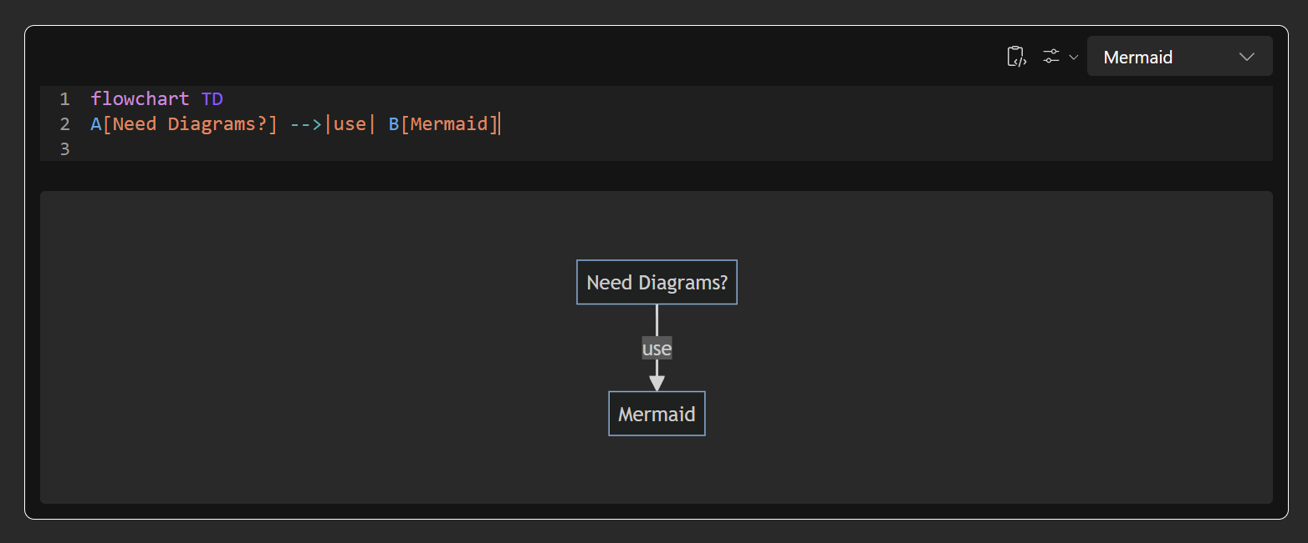
Microsoft Loop

Slide 26
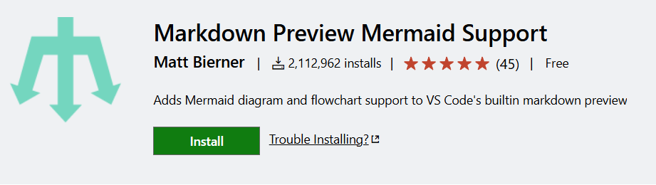

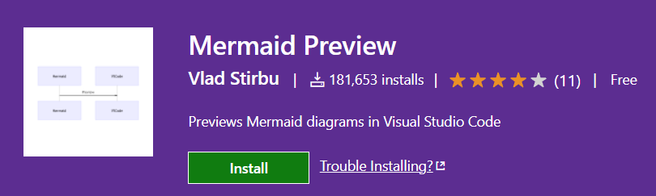

Visual Studio Code
Extension required

Slide 27

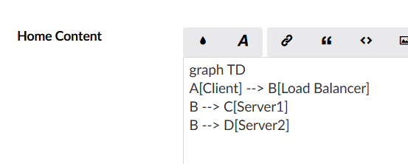
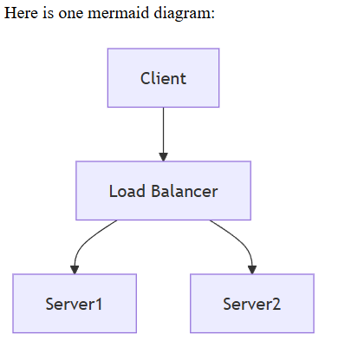
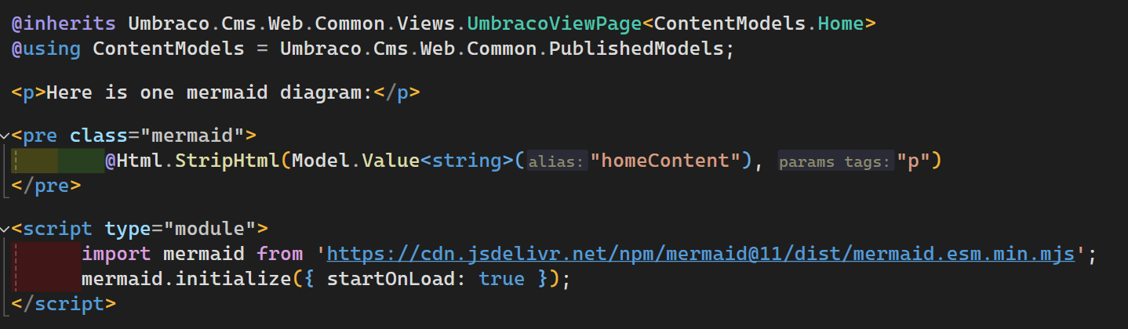
Umbraco CMS (v13)
[Markdown Editor]

Slide 28
Notes:
Import module (by any means necessary) – CDN, NPM package etc.
Create a pre tag with class “mermaid”
Import content, removing <p> tags

Slide 29
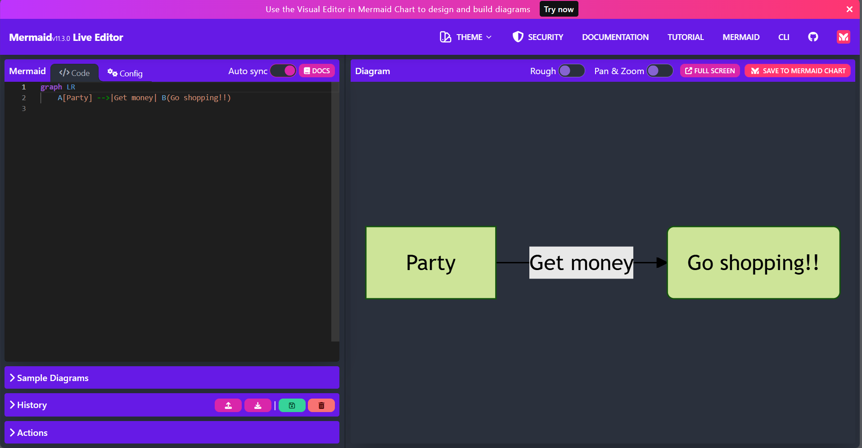
Mermaid Live Editor

Slide 30
Mermaid Live Editor

Slide 31
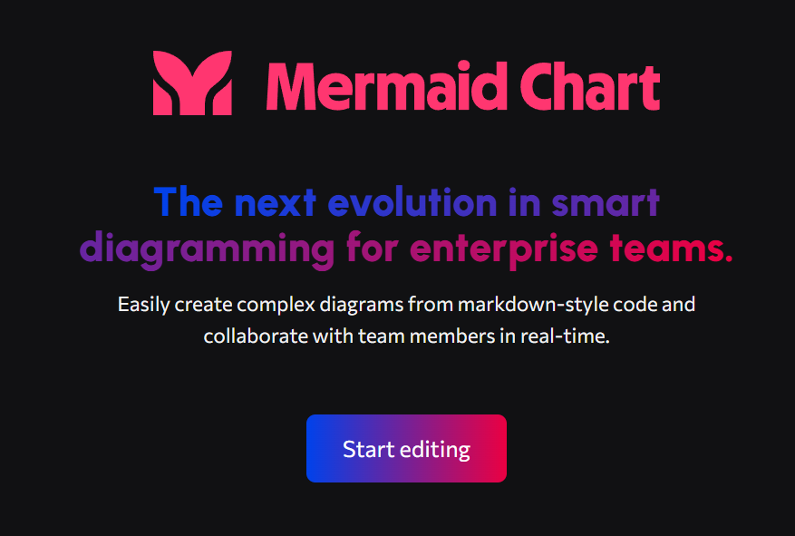
AKA a commercialised platform hosting Mermaid tools
All integrations shown so far have been free

Slide 32

Screenshot:
7th November 2024

Slide 33
4. Usage

Slide 34
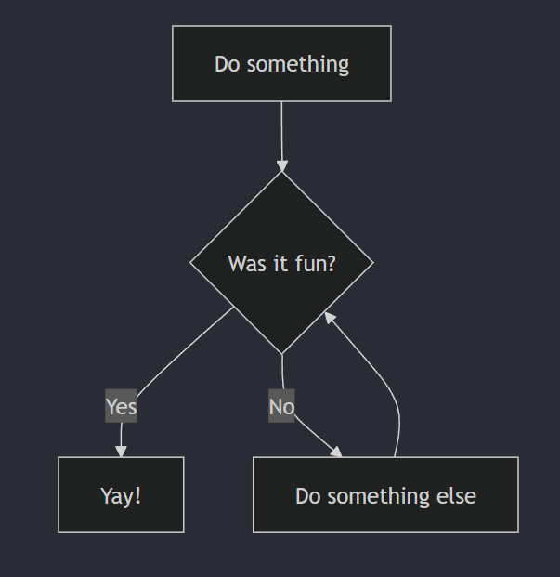
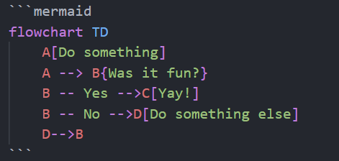
Example: Flowchart

Slide 35
Syntax
Language specifier
Metadata
Chart type
Shape text
Variable initialiser
Arrow type
Shape definition

Slide 36
Example: Flowchart
Metadata

Slide 37
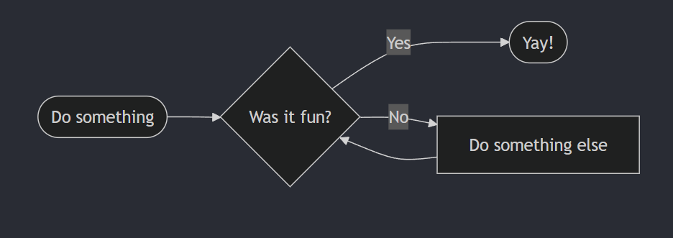
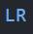
Example: Flowchart

Slide 38
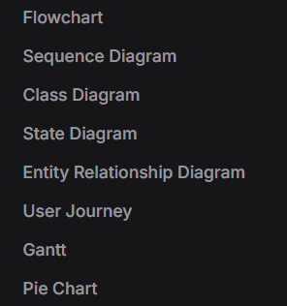
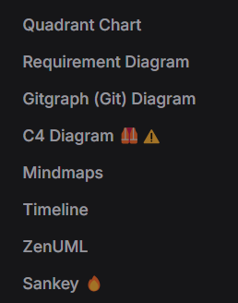
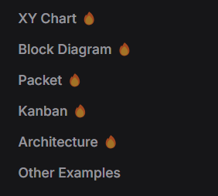
Diagram Types
(added Oct 30th)

Slide 39
[ ADD THREE OTHER EXAMPLES ]

Slide 40
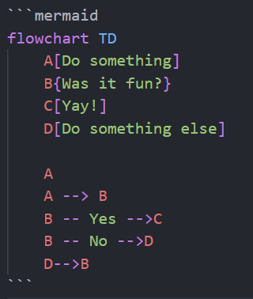
Separate Assignation to Usage

Slide 41
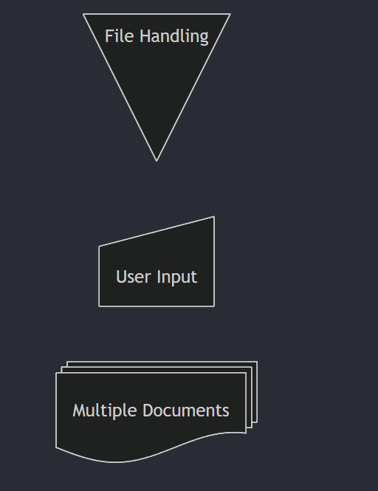
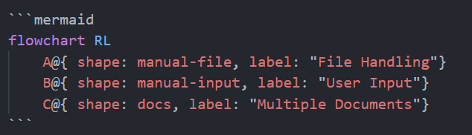
Defining Shapes
Flowcharts Syntax | Mermaid

Slide 42
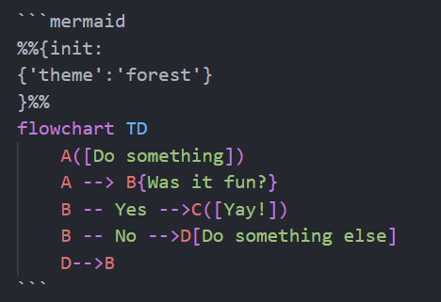
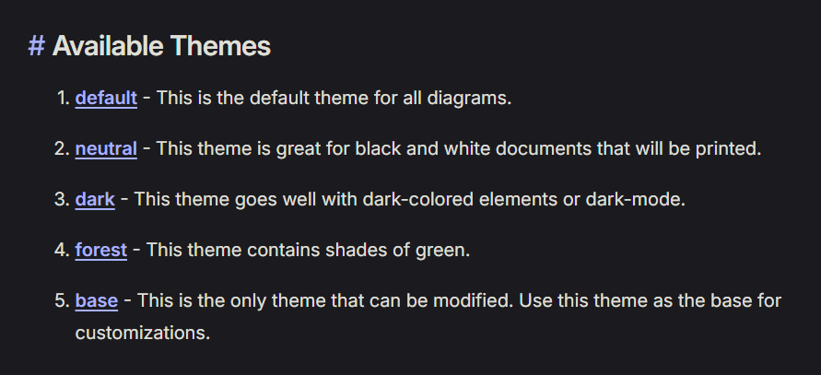
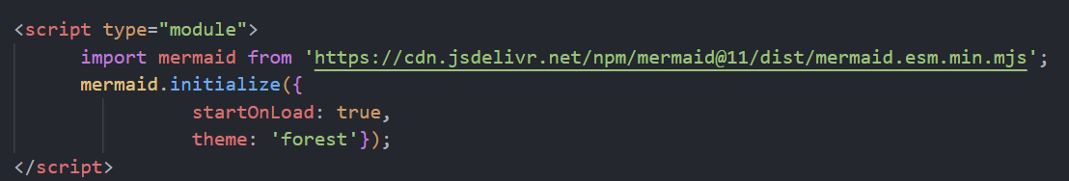
THEMES

Slide 43
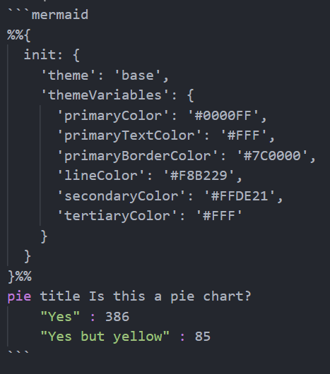
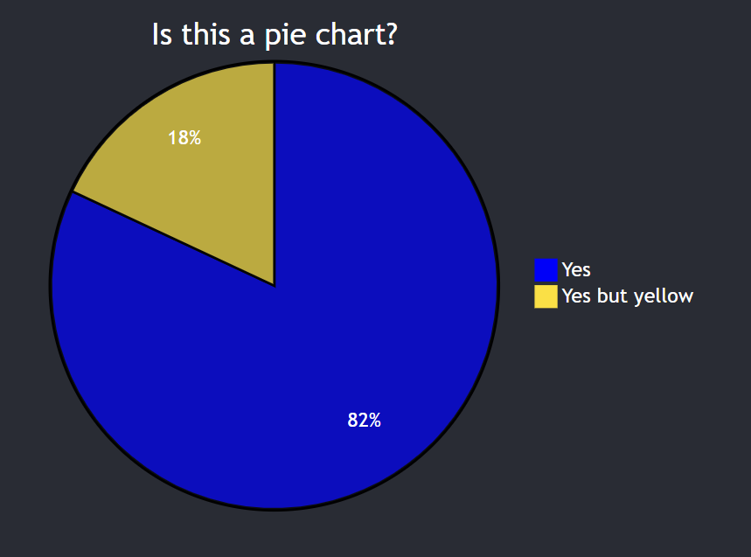
THEMES
Base theme

Slide 44
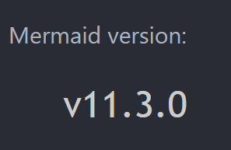
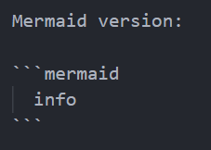
Checking Versions

Slide 45
Click actions
%% Click Actions
click 0_H "https://nightingalehq.ai/";

Slide 46
Mermaid limitations
HIGHLY opinionated – users have zero control over layout
No swimlanes (!!!)
Use swimlanes in flowchart diagram · Issue #2028 · mermaid-js/mermaid

Slide 47
AI, Mermaid and Code generation
Use natural language requests to create Mermaid diagrams
Tweak and improve to match what you really want
Use Mermaid to make applications based around diagrams
Tweak and improve to match what you really want

Slide 48
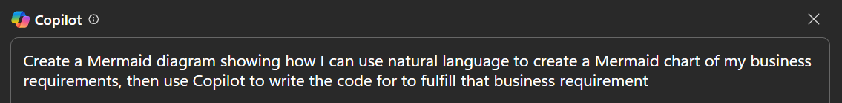
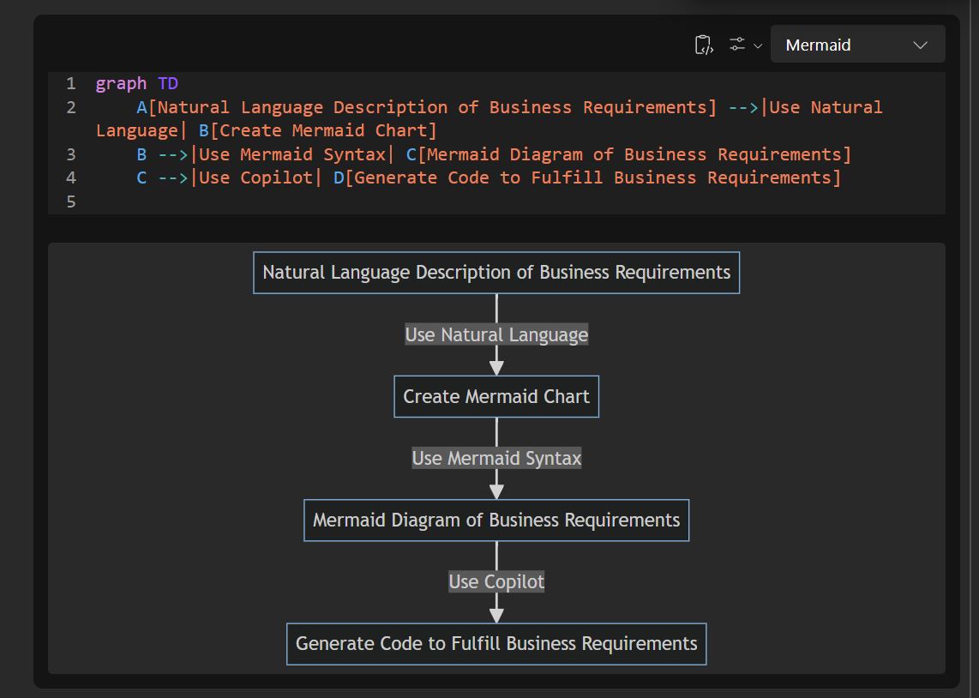
[made in Microsoft Loop]

Slide 49
Copilot’s opinions on the matter:
Clarity and Precision: Mermaid diagrams can provide a clear and precise representation of business requirements, reducing the chances of misunderstandings or misinterpretations.
Enhanced Collaboration: Visual diagrams can facilitate better collaboration among team members, as they provide a common reference point that is easy to understand.
Streamlined Development: By using Copilot to generate code based on well-defined requirements, you can streamline the development process and ensure that the code aligns closely with the business needs.
Improved Documentation: Mermaid diagrams can serve as part of the project documentation, making it easier to maintain and update the project in the future.

Slide 50
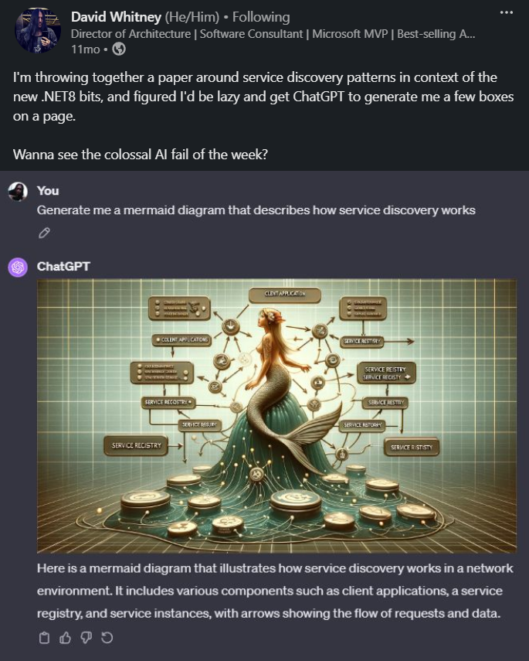

Slide 51
5. Reflections

Slide 52
Key SOLUTIONS
Separate file to the work
Markdown in repo with work
Requires upskilling on graphics package
Code-based upskilling
Developers not necessarily comfortable with aesthetic design
Highly-opinionated layout control
Maps can become unwieldy as scope increases
Shared across multiple markdown files
Proprietary file formats
Markdown files only

Slide 53
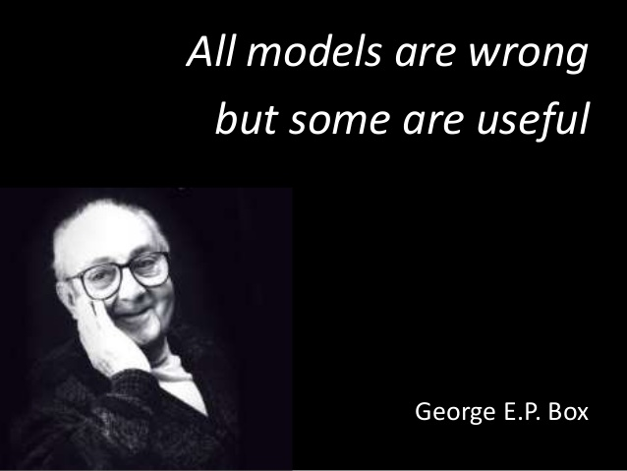

Slide 54

Process Maps for onboarding
Have process maps for new starters
Have new starters make process maps to help them learn / test assumptions
Gives basis for discussion and research

Slide 55


Process Mapping for learning with Feynman Technique
Good for
process mapping
REALLY good for
process mapping
Notes:
There’s no miracle people. It just happens they got interested in this thing and they learned all this stuff. There’s just people.” – Richard Feynman*
Few things have helped me to identify gaps more than having to write out a process map
Two good parts

Slide 56

Process Maps for patience and understanding
Understanding of blockers supports patience
Process maps help to communicate where blockers are most prominent
Required not just within own department but across the business
Notes:
https://www.england.nhs.uk/improvement-hub/wp-content/uploads/sites/44/2017/11/ILG-1.2-Process-Mapping-Analysis-and-Redesign.pdf

Slide 57
Tech Is Hard

Slide 58
Be excellent to each other

Slide 59
Thank you for listening!
Richard Jackson
@jacksorjacksor
All code snippets:
github.com/jacksorjacksor
Umbraco Kent Meetup | 12th November 2024

Slide 60


Q&A

